Slide 1

Final Exam: Question 5
You are required to write code to implement either time-series clustering model using the dataset from Question 1).
Component of Time Series
Make data to be “Stationary”
Check Stationarity
Rolling statistic
ADCF Augmented Dickey-Fuller (ADF) Test
ARIMA Model
Predict the next 5 years Index using Time-series clustering:
SNP - S&P 500 Index

Slide 2
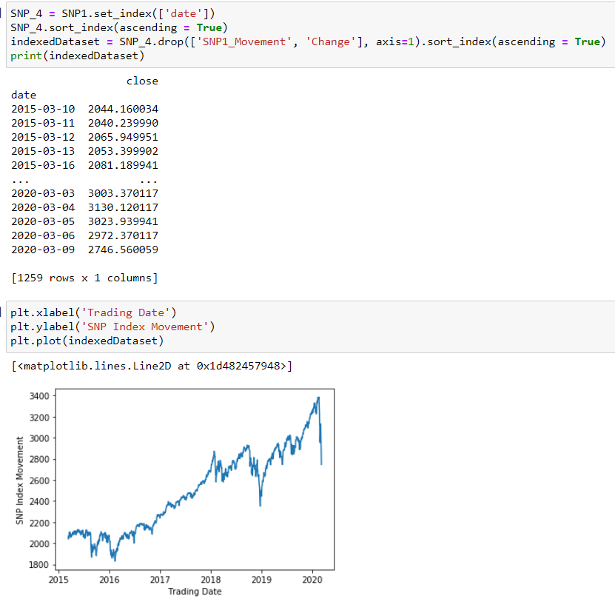
Step 1 : Perform the code below set the date to index and visualize the data as follows
(Using SNP as an example to present the answer):

Slide 3
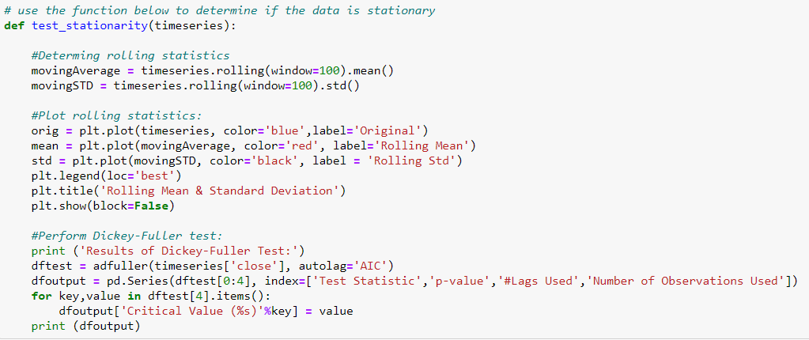
Step 2 : Create a function to create Rolling Statistic and ADCF model to check the stationary
(Using SNP as an example to present the answer):

Slide 4
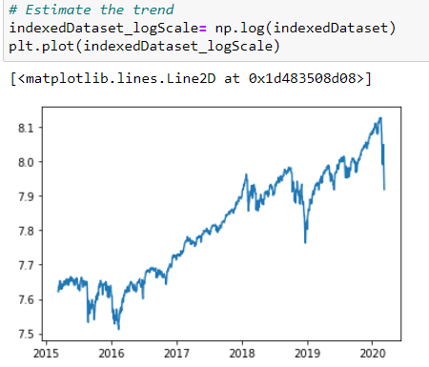
Step 3 : Making dataset stationary
i : Scale or normalize the dataset using Log

Slide 5
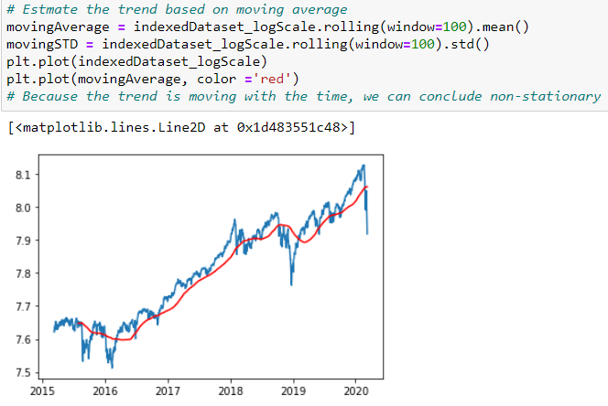
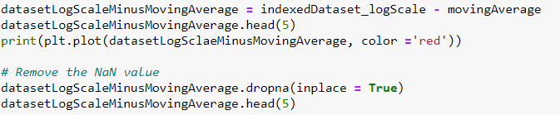
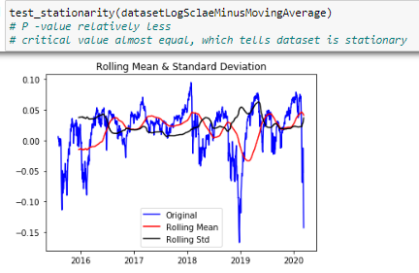
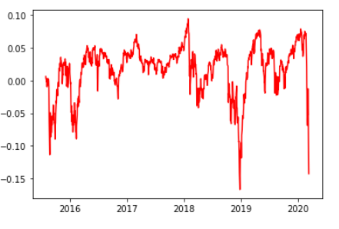
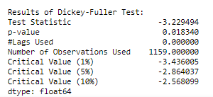
Step 4 : Making the dataset to become stationary by applying
Constant Mean
Constant Variance
Auto covariance that does not depend on time
i : Applying constant Mean
ii : Applying constant Variance
iii : Check Stationarity

